Slide 1


Building a new police station in London IBM Capstone Project Presentation

Slide 2



Intro
Problem: Deciding where to build a new police station in London
My project will use the python skills which I have learnt so far to help decide where to build a new police station in London. I have chosen to address this problem because I have a genuine interest in what the data may reveal. Areas with a high crime rates may benefit from police station of close proximity to improve response time to crimes. In addition to crime data, the report will also use demographic data of each London Borough and statistical analysis to help drive decision making. This analysis may be of use to the govt/police to assist them in a decision to construct a new police station based on crime hotspots.
Data
Crime Data: The crime data is sourced from the London Datastore
(https://data.london.gov.uk/dataset/london-borough-profiles)
Location Data: The location data is sourced from CARTO (https://joshuaboyd1.carto.com/tables/london_boroughs_proper)
Venue Data: The venue data about police stations is from Foursqaure API call.

Slide 3
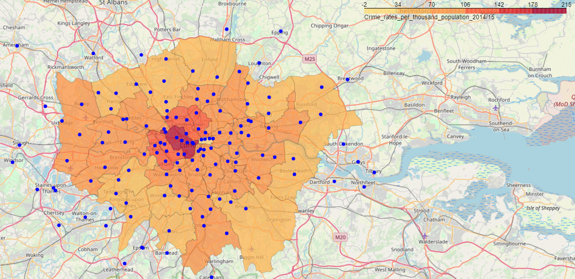
Results
Figure 1: Choropleth map of crime rate for each London Borough with blue circles representing every police station

Slide 4
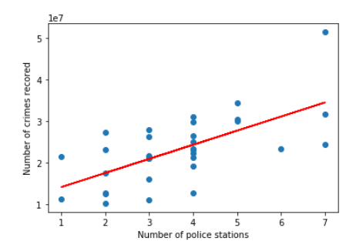
Results
Figure 2: Scatter plot of relationship between number of police station and total crime for each borough with a linear regression

Slide 5
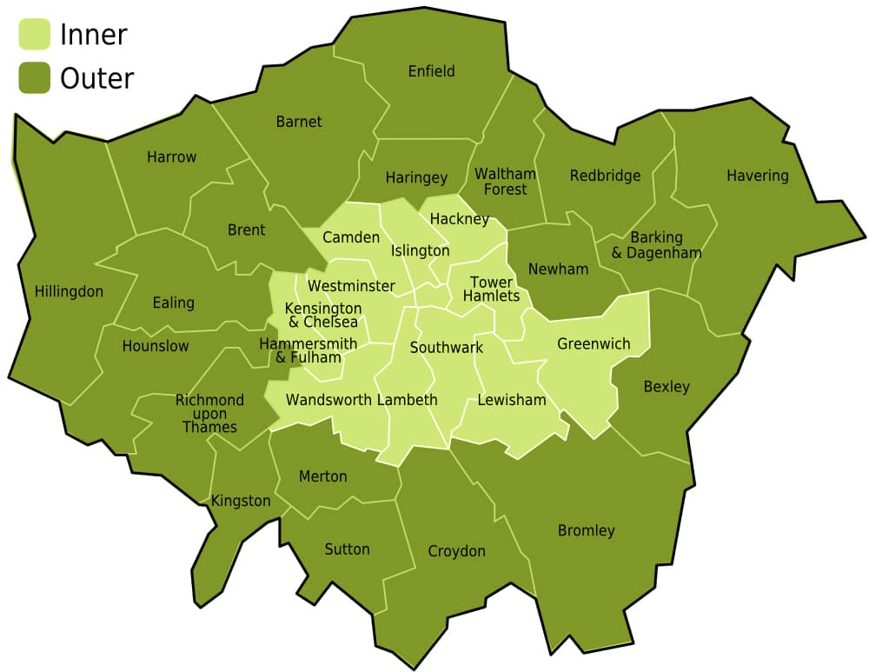
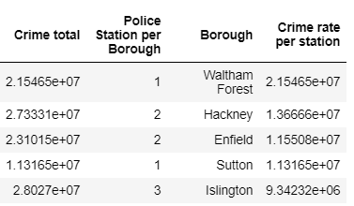
Results
Figure 3: Table show the top 5 boroughs ranked by the total crime rate per police station and the image next to it is the name of every London Borough.
I suggest that the new police station be built in Waltham Forest in the south of the borough so that it can serve both boroughs.
It would definitely make sense to try and construct a new police station in the south of the borough if possible as it could serve both Waltham Forest and Hackney which is very near.

